Slide 1


Pecha Kucha
The presentation from the group6

Slide 2






Overview
02
05
Group Introduction
01
04
03
Tasks
Tasks
Time Line
Contents
Group Study
Group Introduction
Project Plan
Group Study
Project Plan
2

Slide 3










Group Members
Overview
Fengrui Gan
Hengrui Li
Group Introduction
Wantao Li
Xueqing Nie
Group 6
Yingyi Zhang
Tasks
Mingcong Li
Xin Zhang
Zucheng Han
Group Study
Runze Li
Huiyu Wang
Project Plan
3

Slide 4
Group Members
Overview
Group Introduction
Tasks
Group Study
Project Plan
4

Slide 5
Group Members
Overview
Group Introduction
Tasks
Group Study
Project Plan
5

Slide 6
Group Task
Overview
Group Introduction
Docker
Python algo&git
01
02
Tasks
The Process of works
Website
05
03
Group Study
Videos
04
Report
Project Plan
6

Slide 7
Group Task
Overview
Group Introduction
Tasks
Python algo&git
Docker
Website
Report
Videos
All group members will take part in.
1.Wantao Li
2.Yingyi Zhang
3.Huiyu Wang
1.Runze Li
2.Fengrui Gan
3.Xin Zhang
4.Huiyu Wang
5.Mingcong Li
6.Zucheng Han
1.Hengrui Li
2.Wantao Li
3.Fengrui Gan
4.Yingyi Zhang
5.Zucheng Han
6.Xueqing Nie
1.Hengrui Li
2.Fengrui Gan
3.Mingcong Li
4. Xueqing Nie
Group Study
Project Plan
7

Slide 8
Group Task
Overview
Group Introduction
Tasks
Python algo&git
Docker
Website
Report
Videos
All group members will take part in.
1.Wantao Li
2.Yingyi Zhang
3.Huiyu Wang
1.Runze Li
2.Fengrui Gan
3.Xin Zhang
4.Huiyu Wang
5.Mingcong Li
6.Zucheng Han
1.Hengrui Li
2.Wantao Li
3.Fengrui Gan
4.Yingyi Zhang
5.Zucheng Han
6.Xueqing Nie
1.Hengrui Li
2.Fengrui Gan
3.Mingcong Li
4. Xueqing Nie
Group Study
Project Plan
8

Slide 9

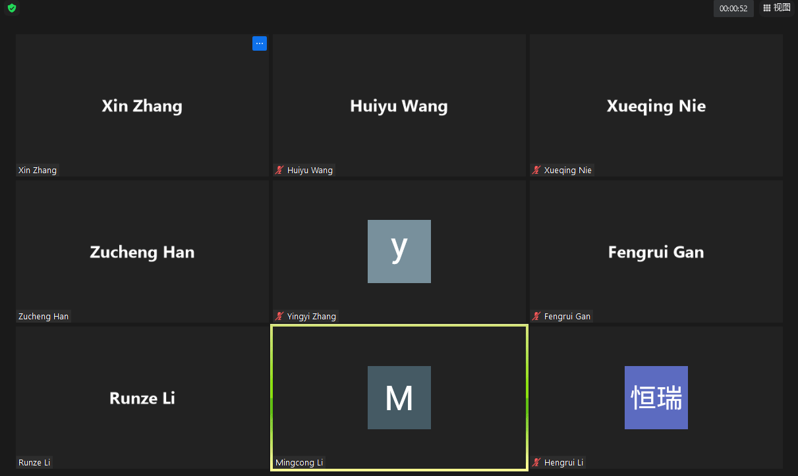
Communication
Overview
Group Introduction
Tools
Form
Tasks
Whatsapp
Wechat
Zoom every week
Task completed in groups
Records written for next group
Group Study
Project Plan

Slide 10


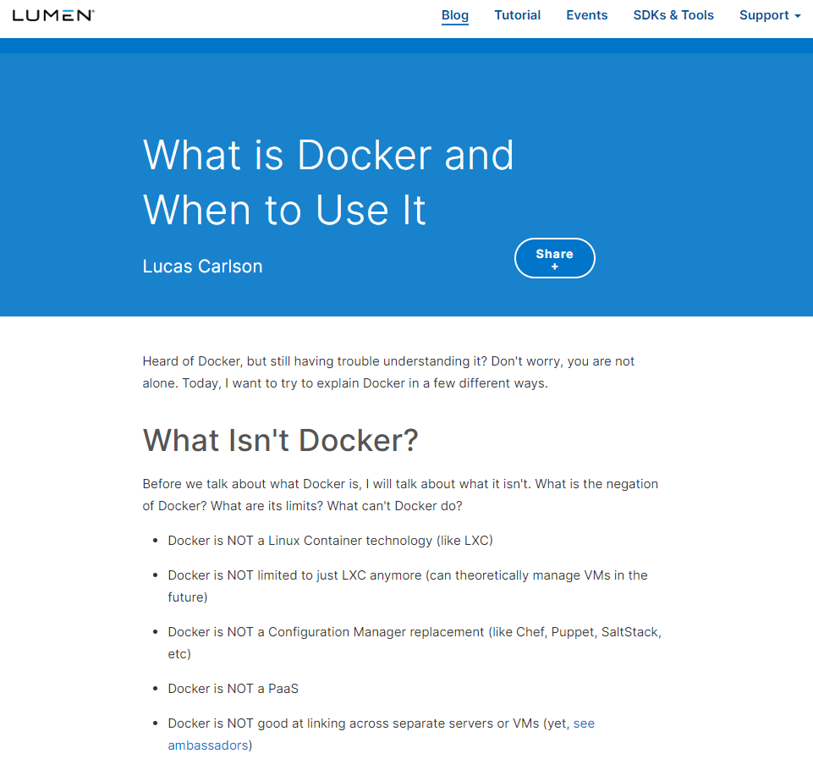
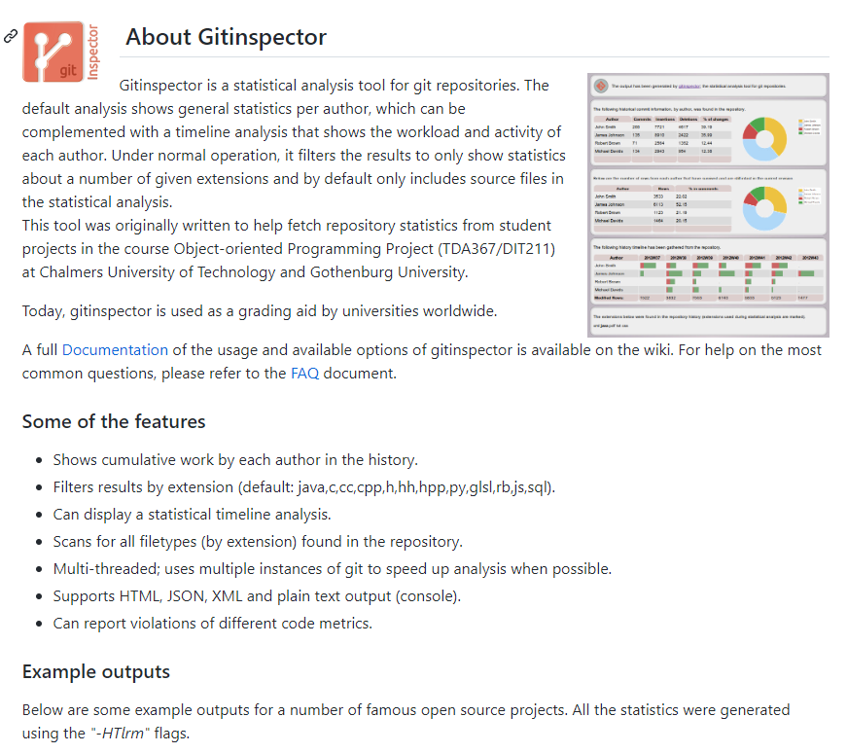
Communication
Overview
Group Introduction
Tasks
Group Study
Zoom Meeting
- Additional learning / reading contents
Technical and theoretical Help
Progress report
Project Plan

Slide 11
Organization Problem
Overview
Group Introduction
Different member capabilities
Challenges
Group progresses differently
Tasks
Unexpected situation
Group Study
Project Plan
11

Slide 12

Group Study
Overview
Procrastination
Time Management & Control: Deadline
Linear Cooperation: A→B→C
Multi-tasking, multi-group
Group Introduction
Tasks
Group Study
Project Plan
12

Slide 13
Group Study
Overview
Procrastination
Time Management & Control: Deadline
Linear Cooperation: A→B→C
Multi-tasking, multi-group
Group Introduction
Individualism
Tasks
Group Leader
Group Work Division
Group Study
Project Plan
13

Slide 14
Group Study
Overview
Procrastination
Time Management & Control: Deadline
Linear Cooperation: A→B→C
Multi-tasking, multi-group
Group Introduction
Individualism
Tasks
Group Leader
Group Work Division
Experience Sense
Group Study
Expression of needs
Too many tasks? Ask for help!
Project Plan
Lazybones
Downplaying work content
14

Slide 15

Project Plan
Time line
Overview
Group Introduction
Data Cleaning
Data Integration
Data Transformation
Data Reduction
Tasks
Group Study
Data
3rd week
Project Plan
1st weeks
15

Slide 16
Project Plan
Time line
Overview
Choosing
Training
Evaluating
Group Introduction
Tasks
Val & Test
Group Study
Algo & Model
6th week
Data Analysis
Project Plan
3rd week
1st weeks
16

Slide 17

Project Plan
Time line
Overview
Group Introduction
hiking day
Tasks
Val & Test
7th week
Group Study
Algo & Model
6th week
Data Analysis
Project Plan
3rd week
1st weeks
17

Slide 18
Project Plan
9th week
Time line
Overview
Video & Final Report
Group Introduction
8th week
Web & Docker
hiking day
Tasks
Val & Test
7th week
Group Study
Algo & Model
6th week
Data Analysis
Project Plan
3rd week
1st weeks
18

Slide 19

Project Plan
Time line
Overview
Group Introduction
“The secret of getting ahead is getting started.”
– Mark Twain
Tasks
Group Study
Project Plan
19

Slide 20
Thank you
FOR YOUR ATTENTION
Source: https://stock.adobecom/

